Slide 1

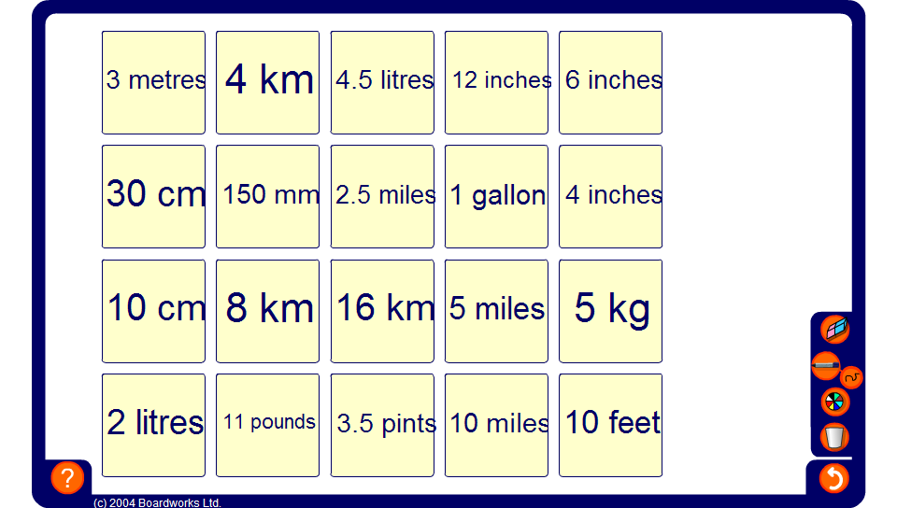


Imperial to metric conversions

